Slide 1
Project Tracking System
Project Guide
M.Sashi Kumar
By
Ailnane ManiHrudhy Rao

Slide 2
Abstract:
A project tracking dashboard is a data-driven platform that displays metrics, stats, and insights that are specific to a particular project or strategy by presenting a tailored mix of KPIs in one central location in order to benefit the project's performance. Also, implementing effective management reports will create a data-driven approach to making business decisions and obtaining sustainable business success.
But despite the business-boosting potential (and vital importance) of successfully delivering collaborative strategies, a mere 58% of organizations understand the value of project management to its fullest, according to the global survey conducted by the Project Management institute. Armed with this knowledge, you can gain a significant edge on the competition and boost your project exponentially.
To put all of the qualities and features of a Project tracking dashboard into real-world context by exploring these essentials total tickets, progress tickets, To-do tickets, completed tickets and also log-Work with estimated time and comments, filter the tickets based on the status.Two login profiles as admin and user.
User functionalities include- Viewing ticket details, Changing the status of ticket and adding comments, Logging work for each ticket, Delete the logs added
Admin functionalities include- Create new ticket, View all tickets as per user and as per status of ticket, Edit the tickets created.
From all these things ,We hope to build project tracking software

Slide 3
Requirements
Two login profiles as admin and user
User functionalities include
Viewing ticket details
Changing the status of ticket and adding comments
Logging work for each ticket
Delete the logs added
Admin functionalities include
Create new ticket
View all tickets as per user and as per status of ticket
Edit the tickets created

Slide 4




Tech Stack

Slide 5
Architecture diagram
Browser
Angular Application
SpringBoot Application
MySql Database

Slide 6
Database
Log Work
log_id INT Primary Key Not Null Auto increment
ticket_id INT Not Null
Ticket
ticket_id INT Primary Key Not null Auto increment
user_id INT not null
Login
description varchar(255) not null
time_spent INT
remaining_time INT
date DATE
title varchar(255)
description varchar(255)
comments varchar(255)
status varchar(255)
estimated_time INT
login_id INT Primary Key not null
designation varchar(255)
password varchar(255)
username varchar(255)

Slide 7
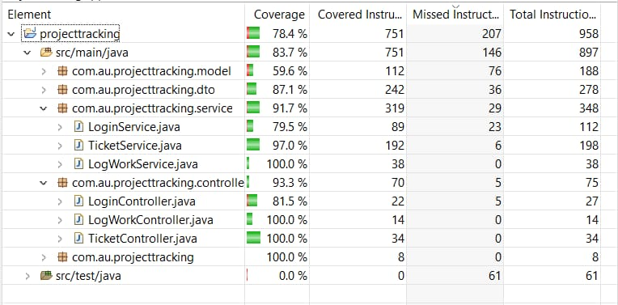
Code Coverage- Backend

Slide 8
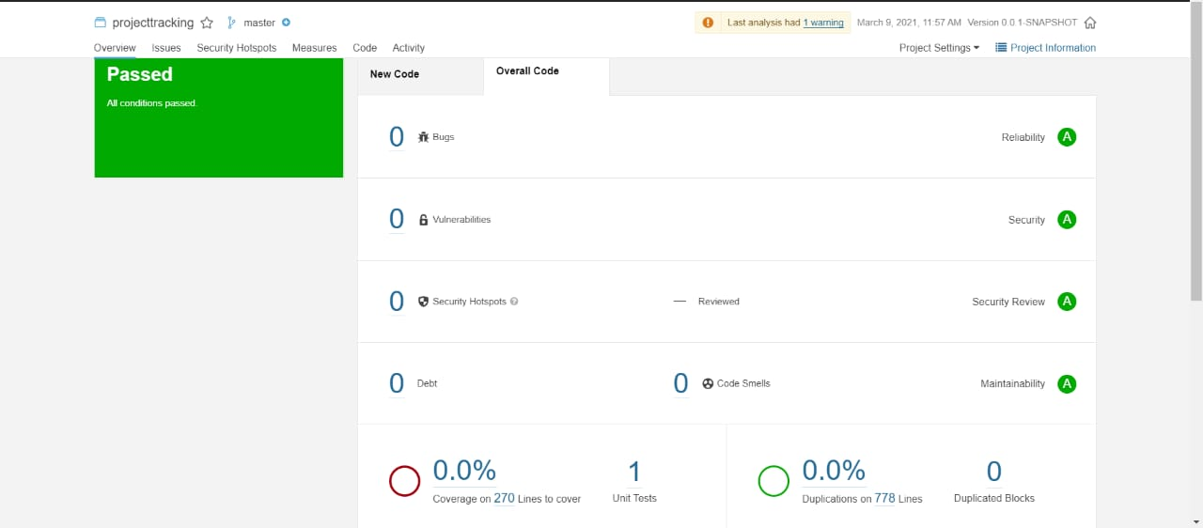
Sonar- Backend

Slide 9
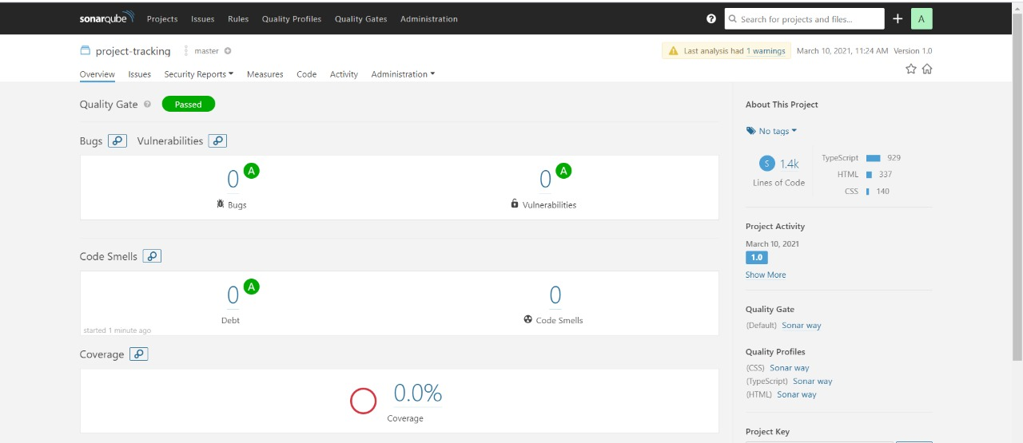
Sonar- Frontend

Slide 10
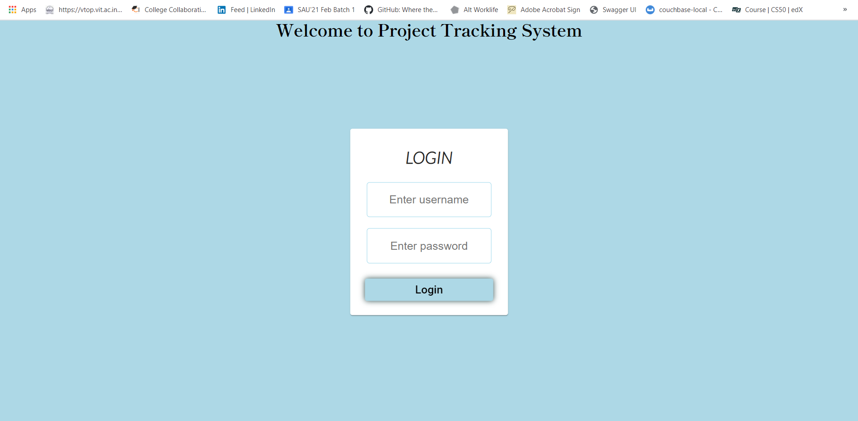
Snapshots of UI

Slide 11
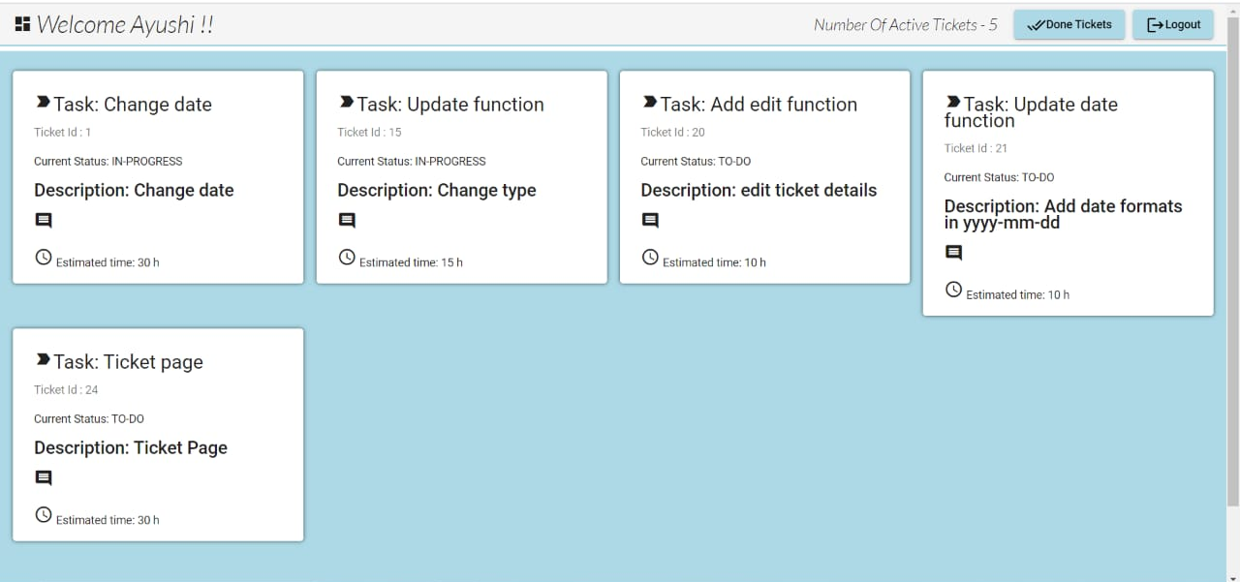
Snapshots of UI

Slide 12
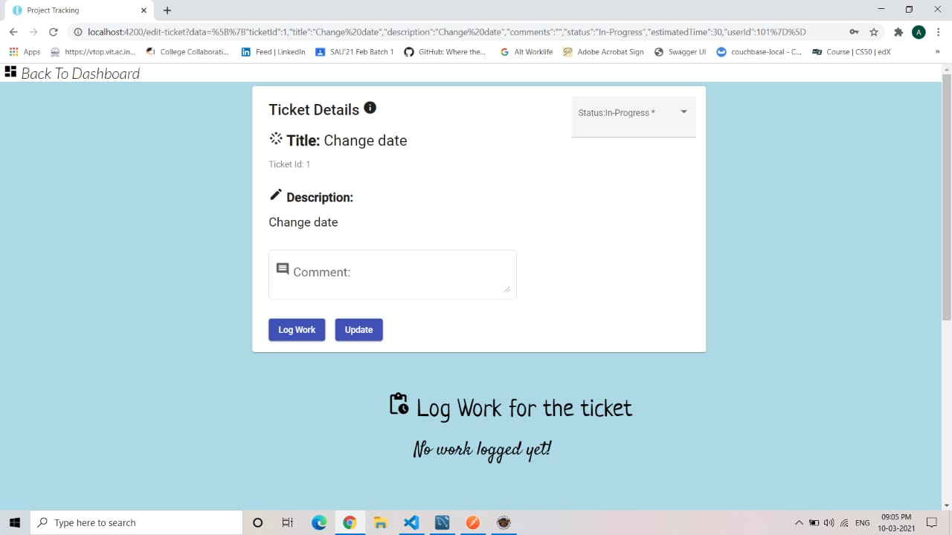

Slide 13
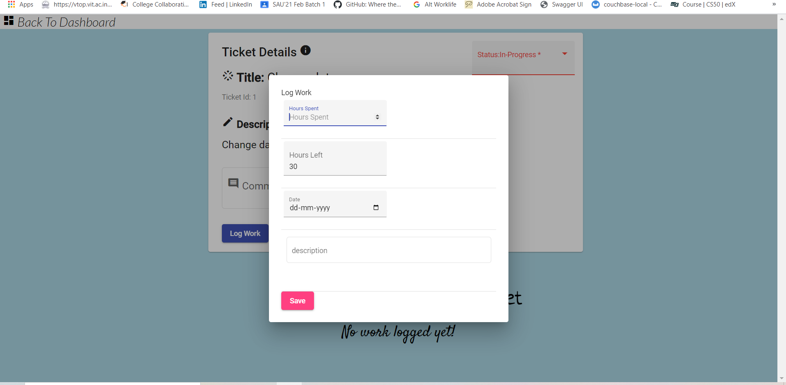

Slide 14
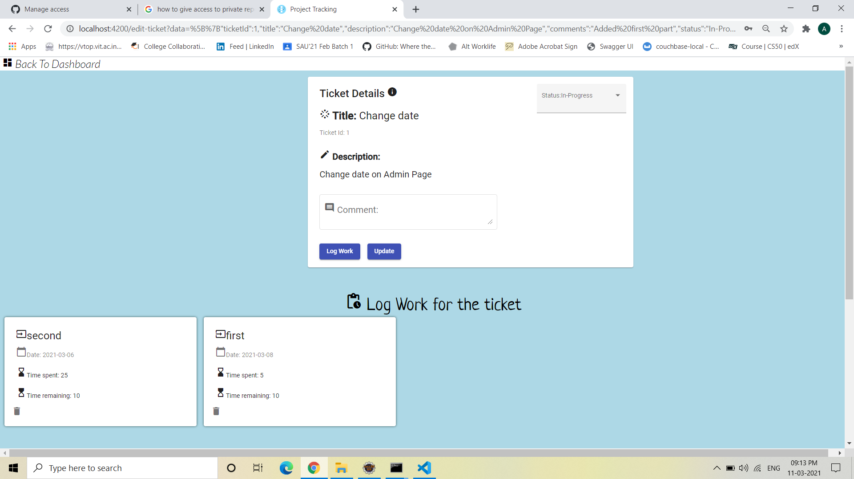

Slide 15
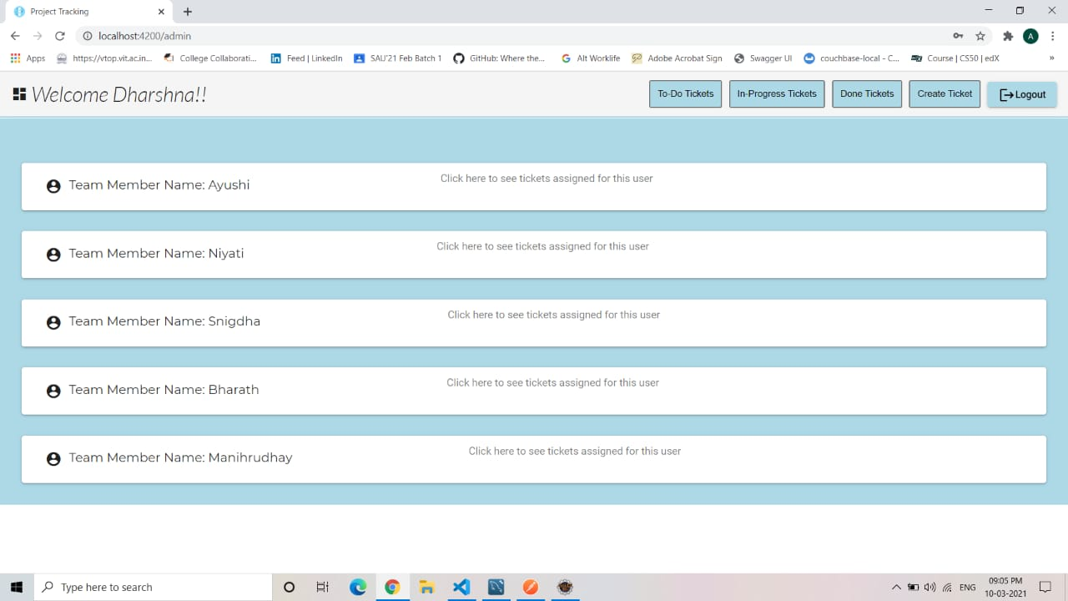

Slide 16
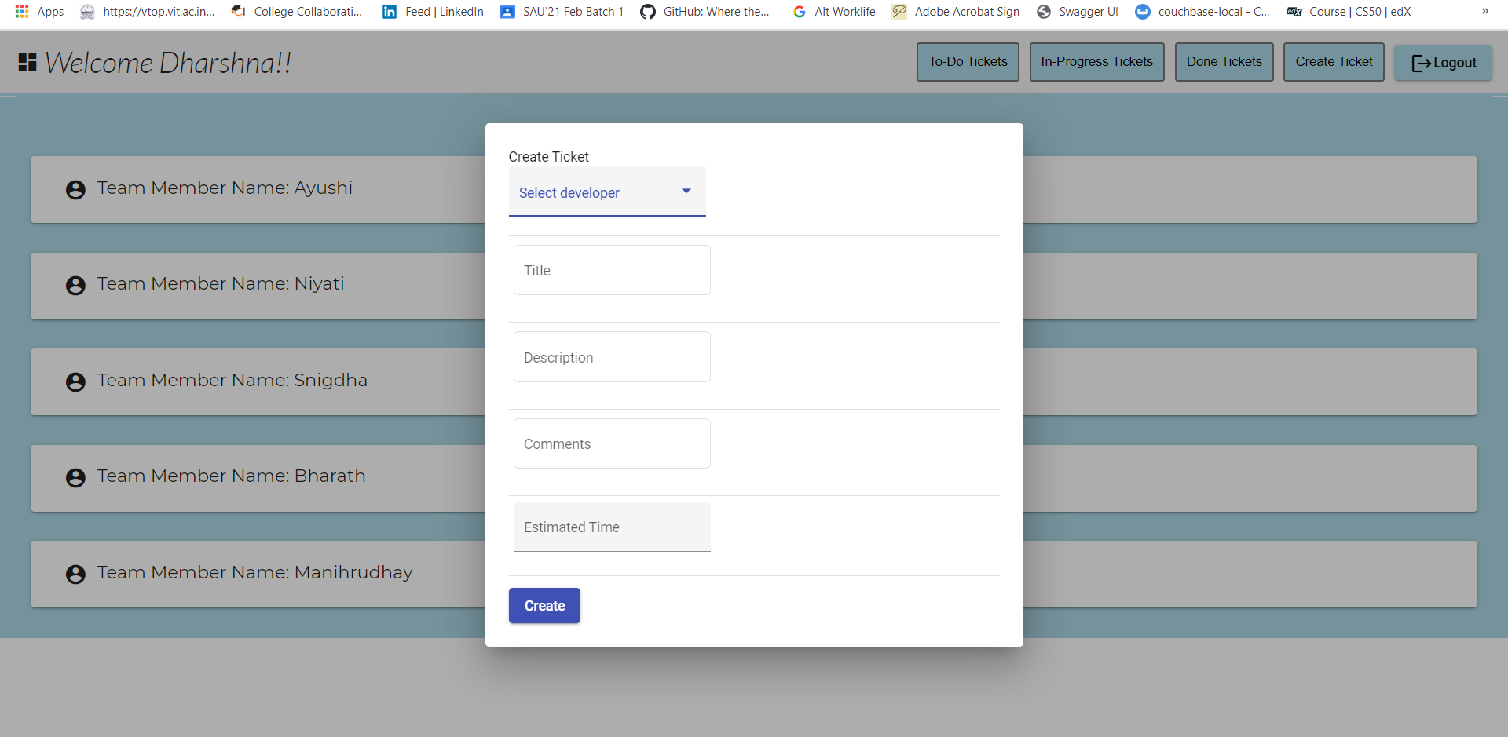

Slide 17
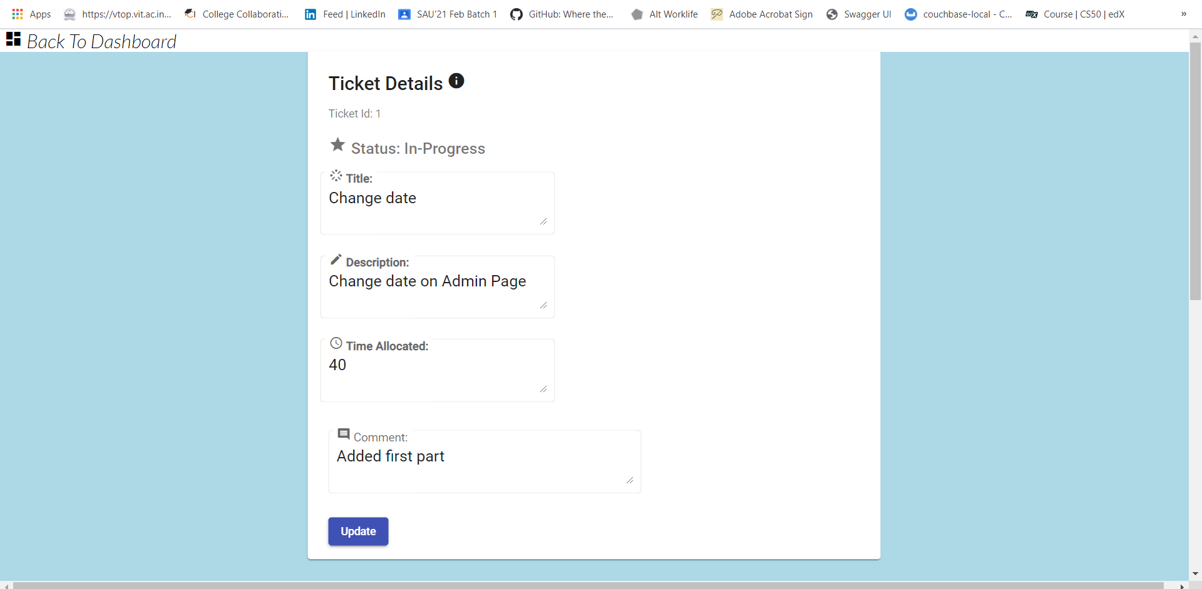

Slide 18
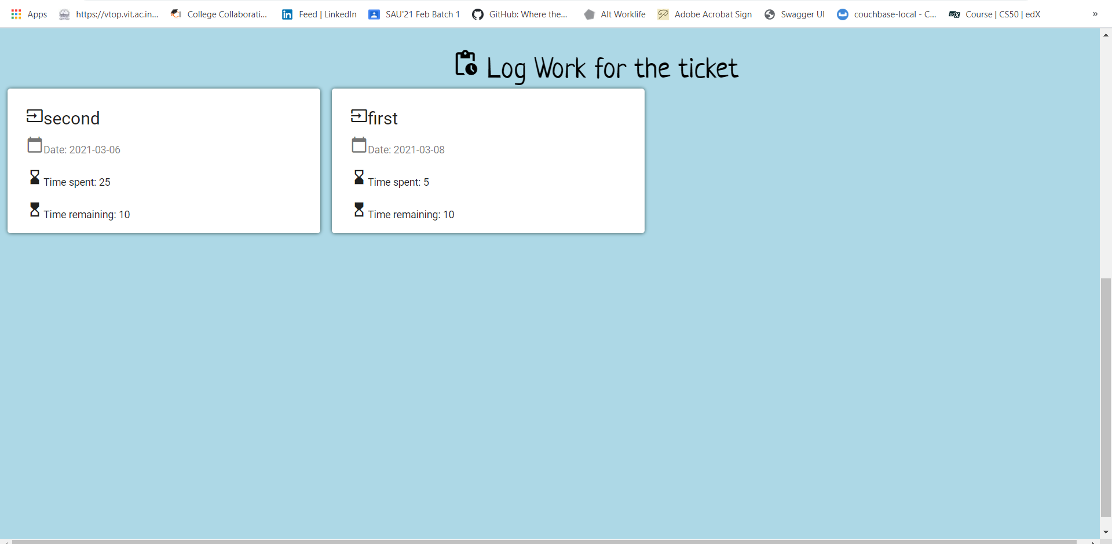

Slide 19
Thank You

